Slide 1

English Premier League (EPL)
Data 2000-2025
Jun Sun, Ruoyao Yan, Wenhan Zhan, Junxiang Wang

Slide 2
Introduction to the Dataset
Source: Kaggle EPL dataset (2000–2025)
Total matches: over 8000 rows, over 20 columns
Key features:
  Match date
  Home and Away teams
  Goals (half-time and full-time)
  Home/Away shots, fouls, corners, cards
  Match outcome (H/D/A)
🇬🇧

Slide 3
Research Questions
Explore key factors that influence match outcomes in the English Premier League using historical data from 2000 to 2025.
Research Question 1:
To what extent does match location (Home vs. Away) influence the probability of winning in the English Premier League?
Research Question 2:
What are the factors that can affect the outcome of a competition?
Research Question 3:
What is the impact of disciplinary metrics : fouls committed, yellow cards, and red cards on the total goal in each match?
📚

Slide 4
Data Cleaning Process
Checked and filled missing values (mean/mode).
Handled invalid/missing match dates
Fixed logical inconsistencies:
Negative or illogical goals (e.g. halftime > fulltime)
Match outcomes inconsistent with goals
Removed temporary columns and exported cleaned dataset.
🧹

Slide 5
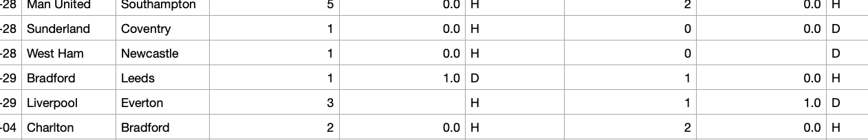
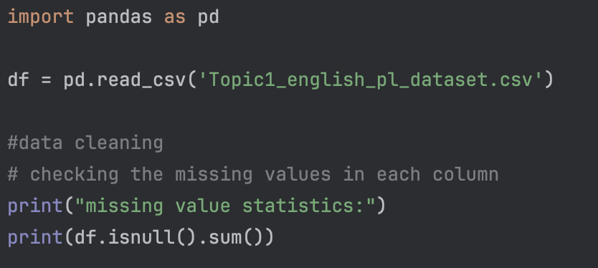
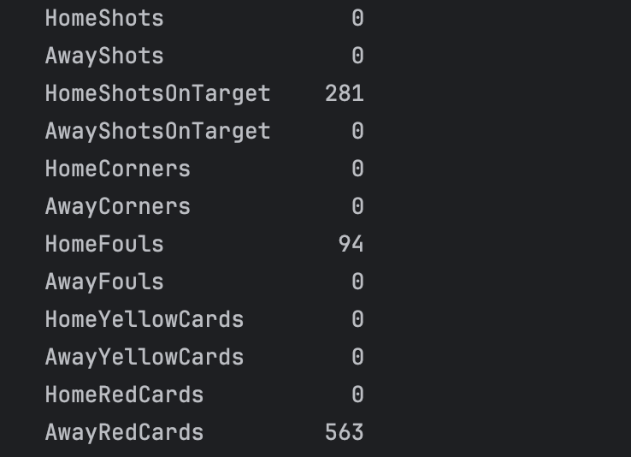
Why are we doing it
Check missing values.

Slide 6
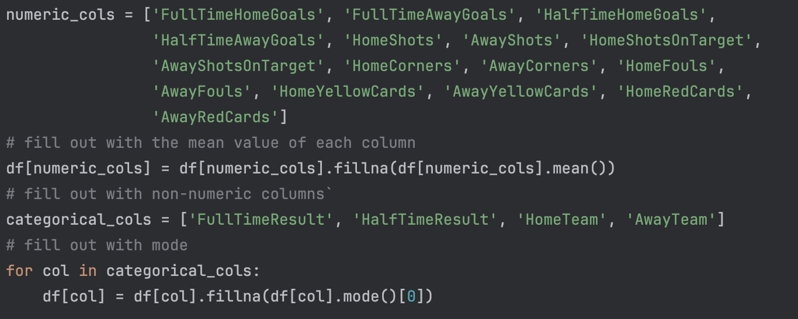
How did we do it:
Numerical data
Categorical data

Slide 7
Pros and Cons
Means method
Minimizes Variance
Preserves Central Tendency
Mode
Works for Categorical Data
Not being too ridiculous
Other decided not using ways
Too hard…😭
🧹

Slide 8
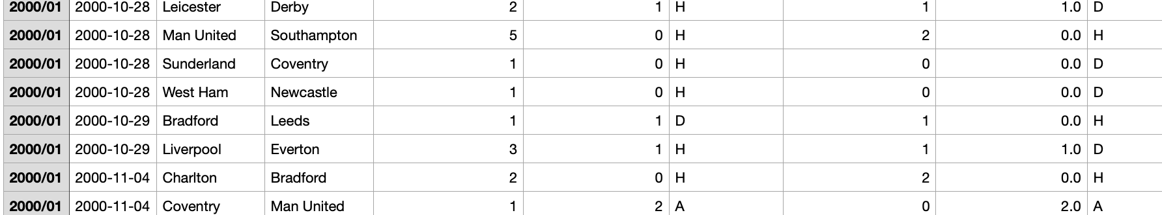
Check list
no floating numbers
no negative numbers
no error match result
no half time goal over full time goal
Result

Slide 9
Summary Statistics
Total 9380 games with in 25 years
Total team participated: 46
Total home win:4291
Total away win: 2726
total yellow cards: 30584
total red cards: 1337
🧹

Slide 10
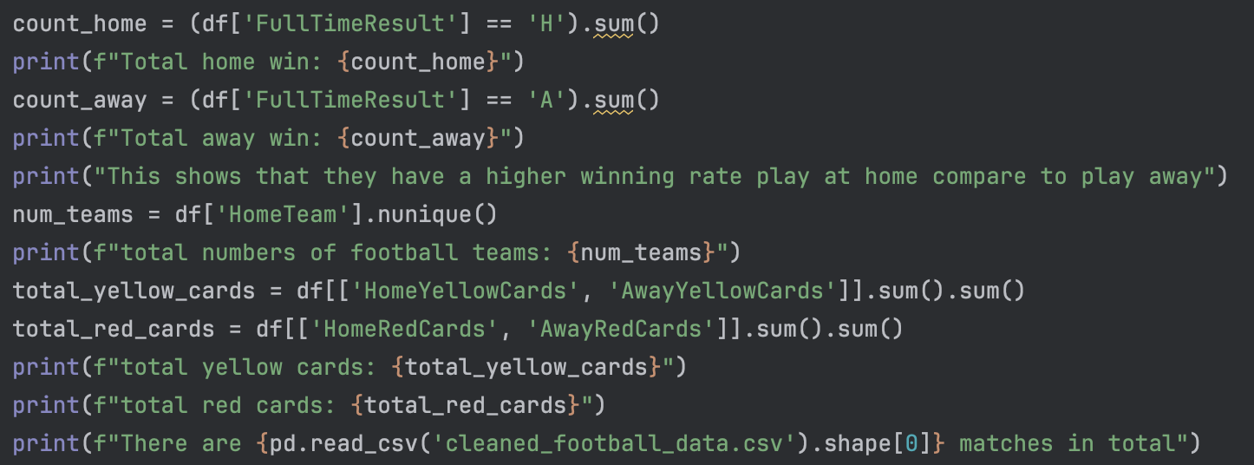
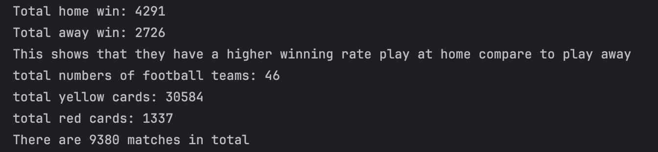
Final programme display
🧹

Slide 11
Exploratory Data Analysis
Trend over seasons:
Number of matches per season
Goal trends over time
Team performance:
Most successful home teams
Most aggressive teams (cards/fouls)
Visualizations:
Bar charts, line plots, heatmaps (e.g., team vs. goals)
📚

Slide 12
Primary data research
Trends in number of matches played
Distribution of home and away team goals (bar chart)
Full-time/half-time result ratio (pie chart)
Home vs Away Win Percentage (bar graph)
📚

Slide 13
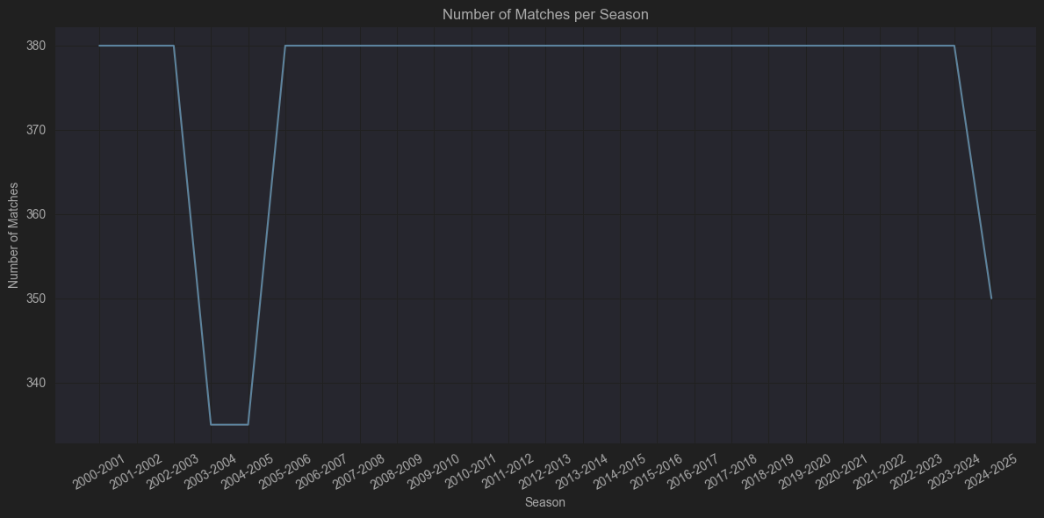
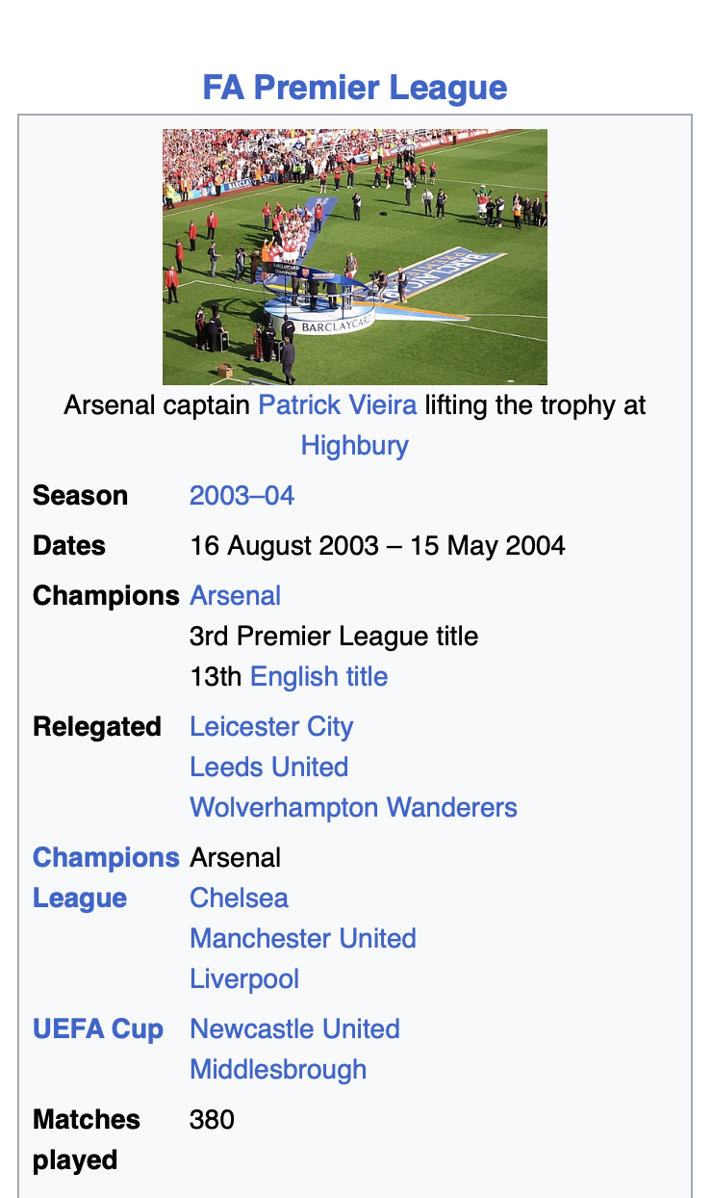
↖️
335 matches

Slide 14
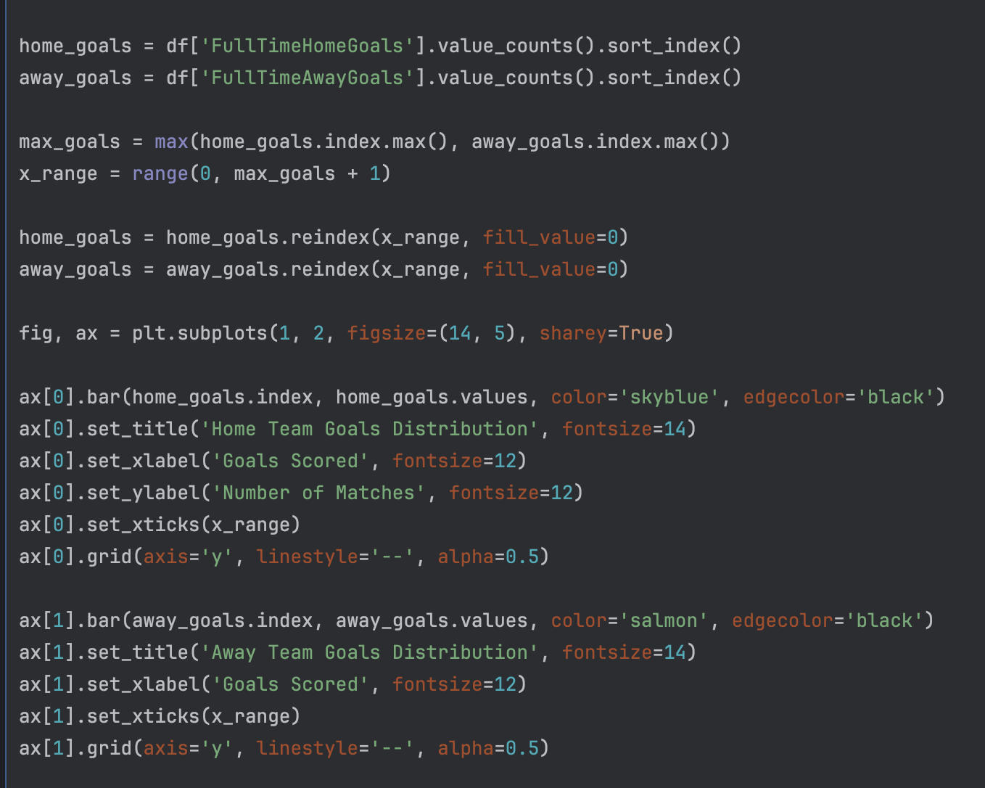
Distribution of home and away team goals (bar chart)

Slide 15
Distribution of home and away team goals (bar chart)

Slide 16
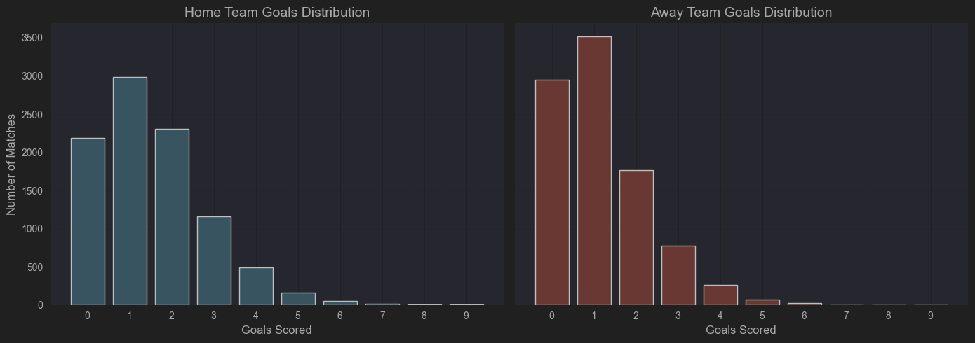
Distribution of home and away team goals (bar plot)
Home team:
Peak is at 1 to 3 goals，especially 1 goal and 2 goals
High scoring like 5 goals above is significantly decreasing, but still some
Away team:
Peak is at 0 to 2 goals ，0 score is way more than home team, shows more disadvantages
High score like 5 goals above is very rare, nearly zero

Slide 17
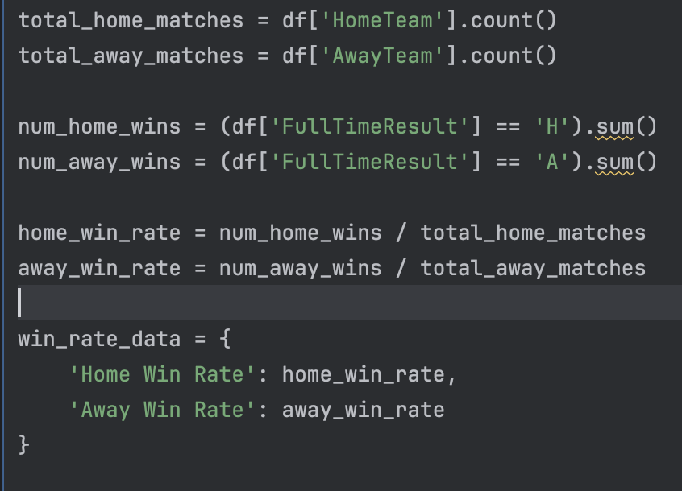
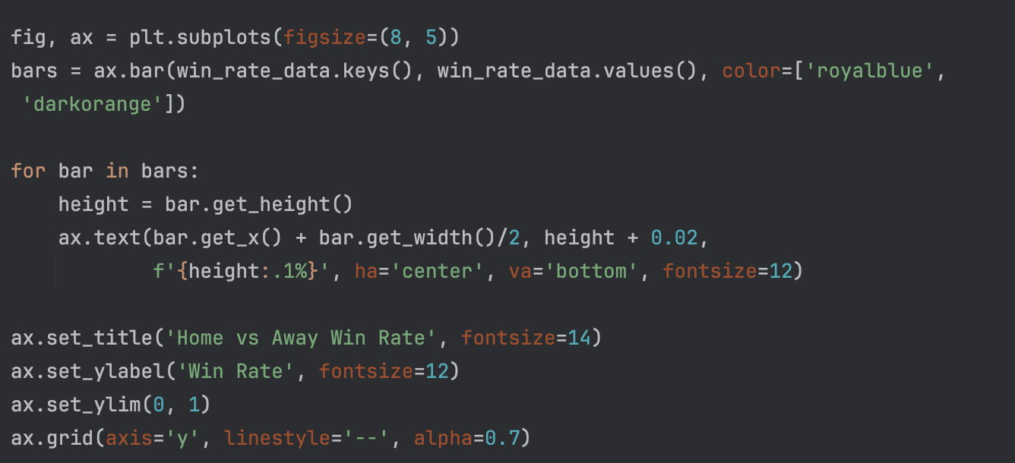
Home vs Away Win Percentage (bar plot)

Slide 18
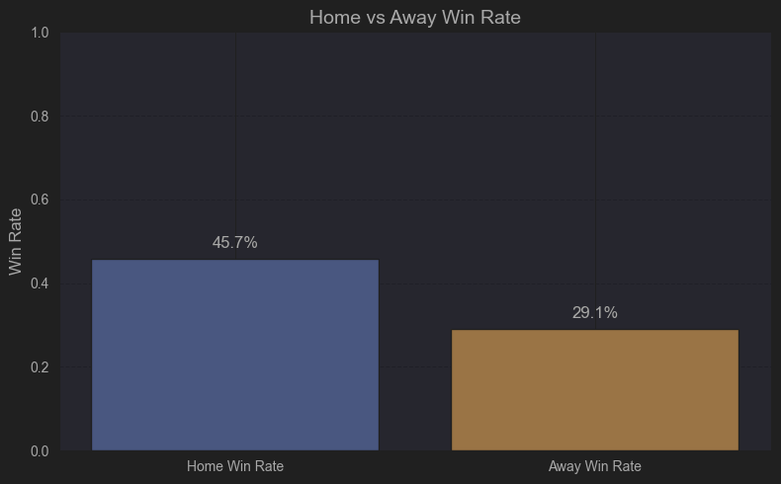
Home vs Away Win Percentage (bar plot)
45.7% home win rate vs 29.1% away (16.6% gap)
25% matches end in draw - highlights game's unpredictability
Reason
Environmental: Familiarity with pitch conditions
Psychological: Home more supporters effect
Officiating: Subconscious referee bias, tend to help home team more

Slide 19
Assumption Testing & Prediction
Predict the number of goals scored by Liverpool as the home team (FullTimeHomeGoals). Use regression to predict.
  sports lotto
  assess Liverpool's home attack efficiency
Use HomeShotsOnTarget to build a goal expectation model to predict Liverpool's specific winning rate in home games
  Prediction of goals per game
  Visualized correlation curve between number of shots on target and winning rate
  Can assist coaches to adjust offensive tactics
Predicting goals using cards and corner kicks
  Positive correlation between corner kicks and goals
  Chain effect of red and yellow cards
  Dynamic adjustment of tactics
📈

Slide 20
Let’s see some stats between two specific teams!
🇬🇧

Slide 21
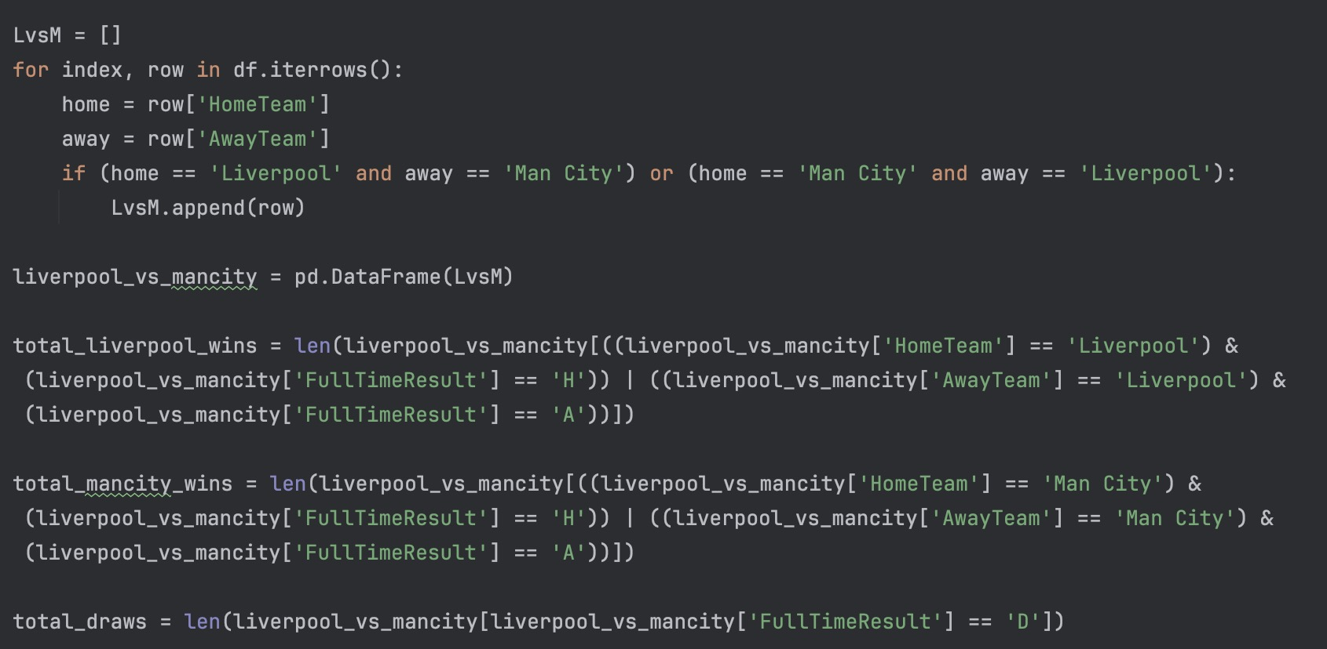
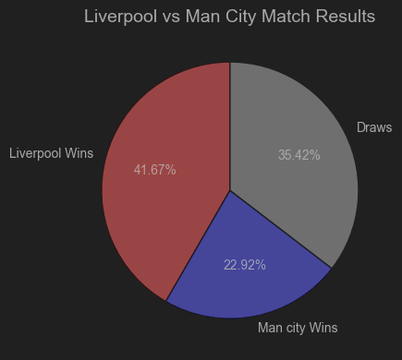
Liverpool vs Man City

Slide 22
Features analysis for machine learning
Average shots per match, shots on target, and goal conversion rate
Average distribution of fouls, yellow cards, and red cards (Home vs Away)
Correlation between corner kicks and win rate
Analysis of the relationship between goal difference and match outcome
📚

Slide 23
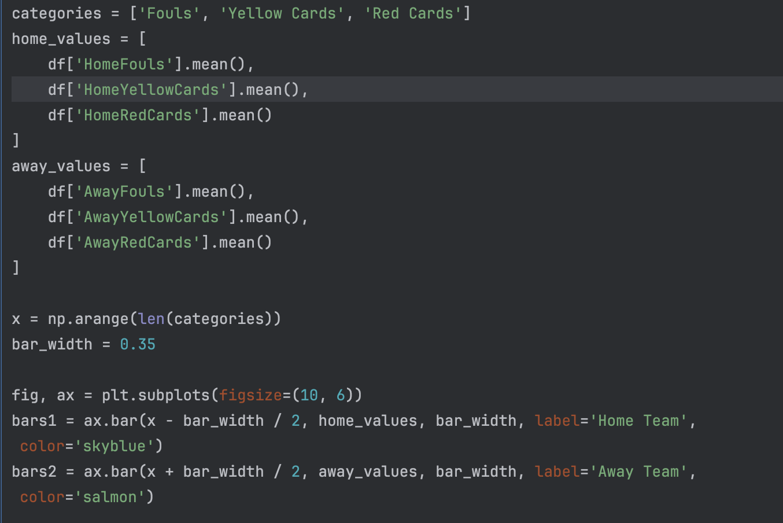
Average distribution of fouls, yellow cards, and red cards (Home vs Away)

Slide 24
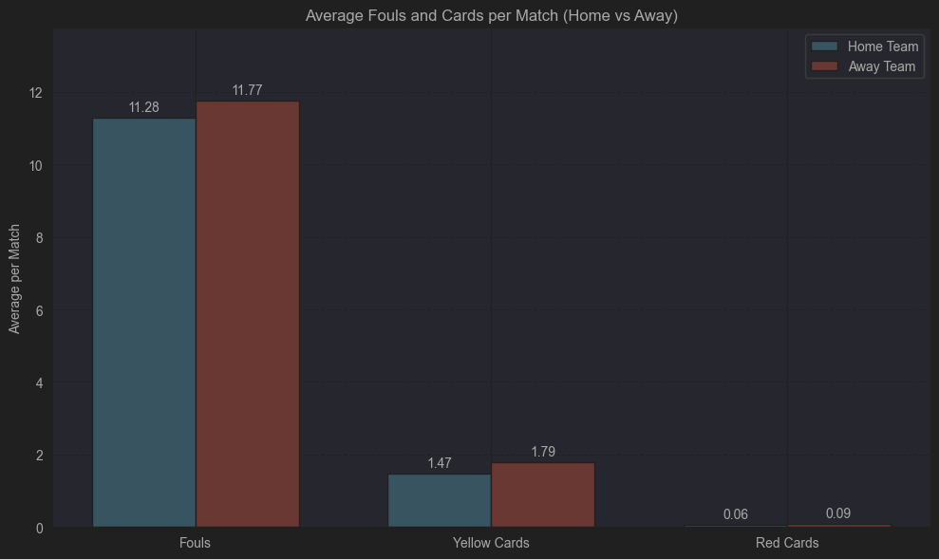
Average distribution of fouls, yellow cards, and red cards (Home vs Away)
Fouls:
11.77 for away teams vs 11.28 for home teams.
Yellow cards: 1.79 for away teams compared to 1.47 for home teams
Red cards: 0.09 for away teams versus 0.06 for home teams
Difference - 0.49 more fouls per game by away teams.
This could stem from:
Defensive postures typically adopted by visiting sides
Increased physical demands of away matches

Slide 25
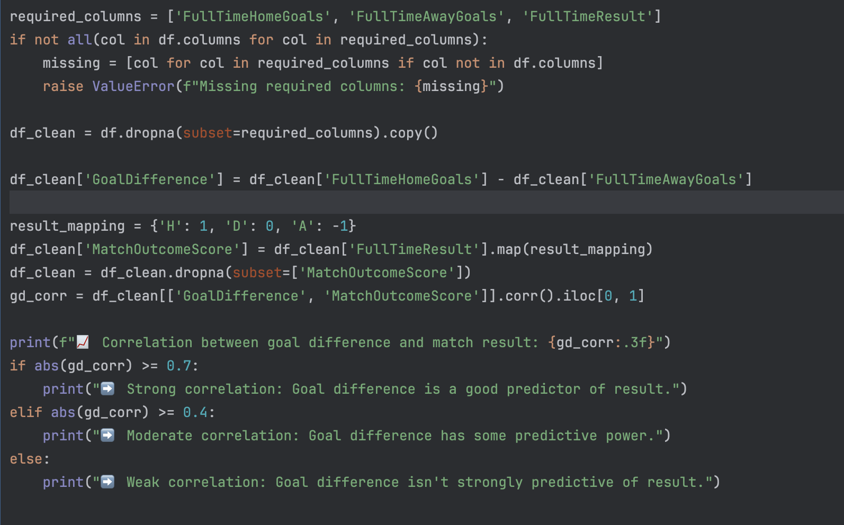
Analysis of the relationship between goal difference and match outcome

Slide 26
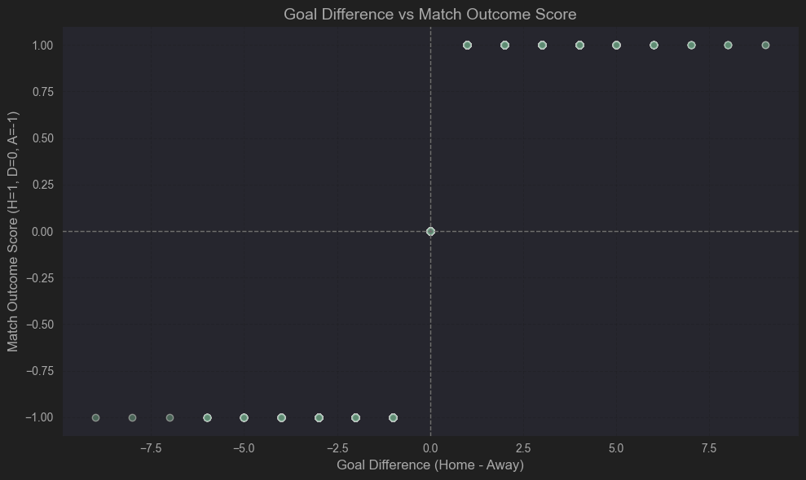
Analysis of the relationship between goal difference and match outcome

Slide 27
Prediction!
📚

Slide 28
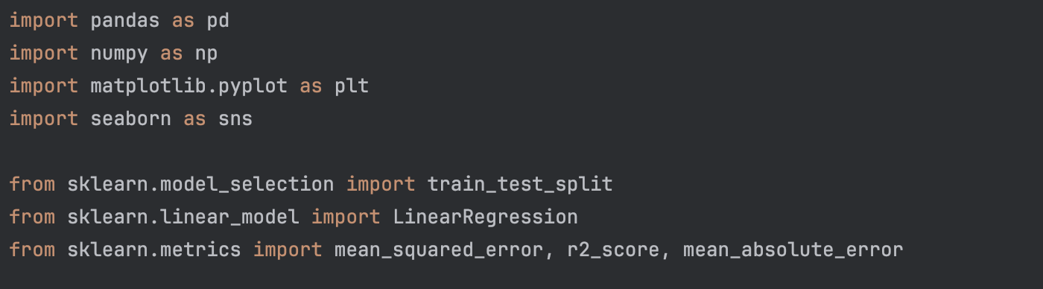
Predicting goals using cards and corner kicks
We choose cards and corners because they:
Directly influence goal-scoring odds.
Are easy to measure objectively.
Have established statistical relationships with goals.
We want to use this to predict score for:
Earn money
Performance evaluation and preparation for the match

Slide 29
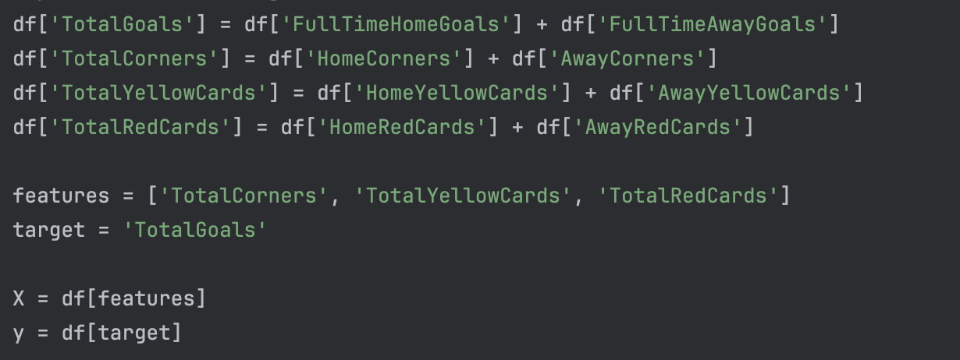
Predicting goals using cards and corner kicks

Slide 30
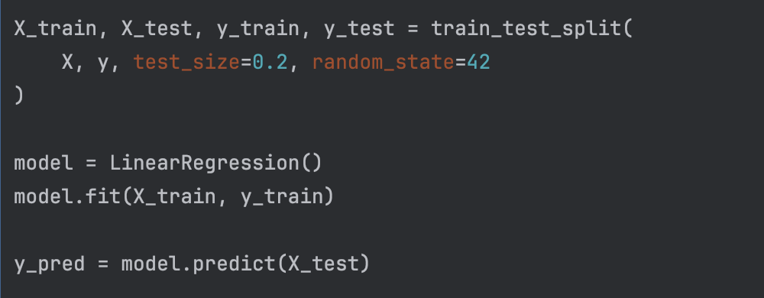
Predicting goals using cards and corner kicks

Slide 31
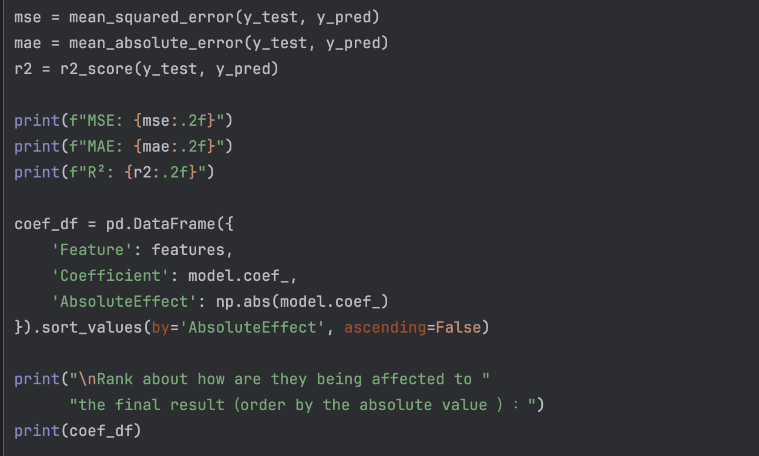
Predicting goals using cards and corner kicks

Slide 32
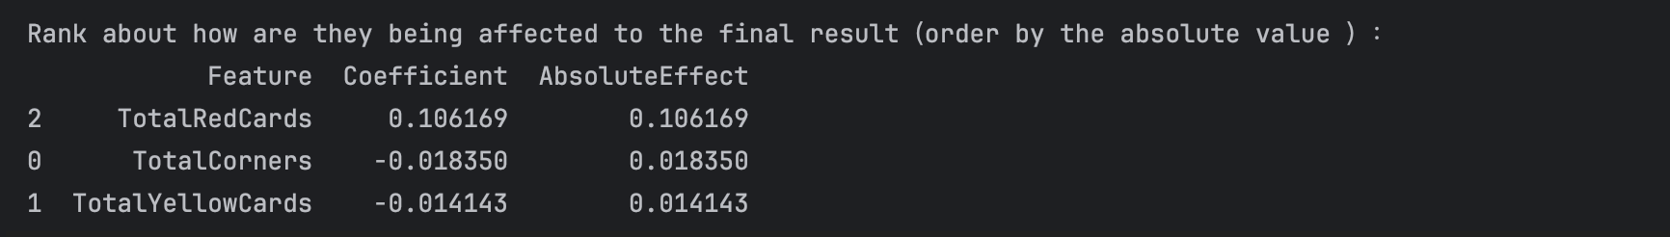
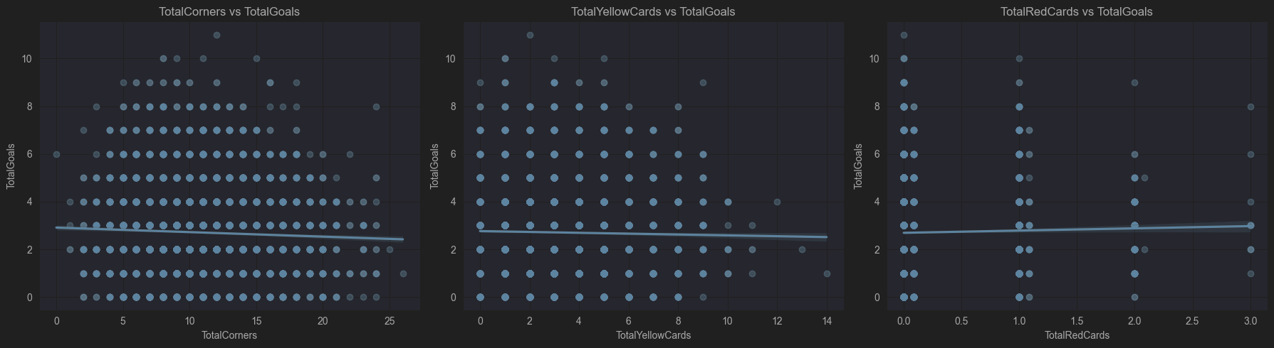
Predicting result
MSE: 2.76
MAE: 1.32
R²: 0.00
The proper range:
MSE between 0.1 – 0.3
R² between 0.7 - 0.85

Slide 33
Conclusion
Understanding for our prediction that why did it fail
  Data is single
  not enough feature engineering for machine learning
  better machine learning technology, such as polynomial regression.
Improvement plan:
  Think from the perspective of football business. Like if I am a data analyst for Chelsea, what questions should I start with to model. If I want to win the Premier League or I want to win as many games as possible, what should the team strengthen during the game?
  Think about other features that could be in use: main coach of a team, star players, financing status of the club
👩🏻‍💻

Slide 34
Q&A
Thank You
🎉

Slide 35
Contribution for the whole project.
The coding part: As attached in the PyCharm
PPT Slide show: Mostly done by Ruoyao Yan
PPT script: written by Jun Sun and Ruoyao Yan

